Slide 1
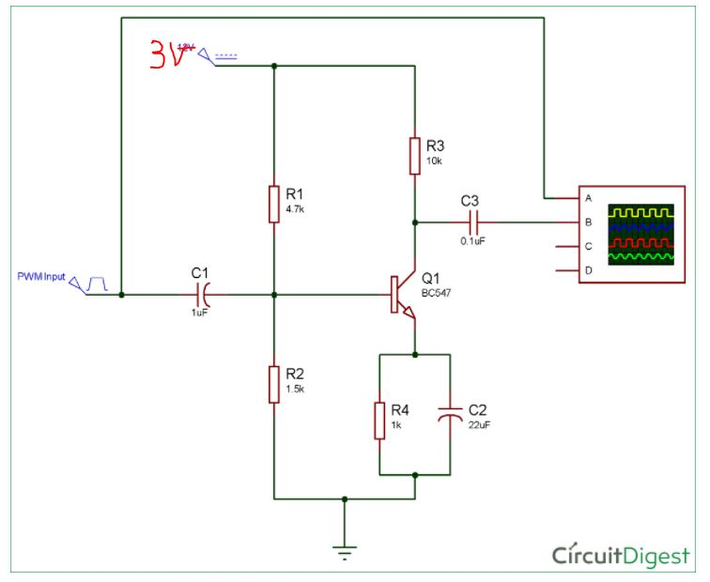
LEDS
Calc R based on the #LEDS
NodeMCU pin D4

Slide 2
